Slide 1

Welcome to Rejoice Visioning Meeting, October 1, 2023
Purpose
To foster spiritual growth, enhance community engagement, and chart a course for the future considering:
Approved 2023 deficit budget of ($50,784)
Rev. Adam Stockton’s new part-time role as NT-NL Synod Youth Connector effective 9/1/23
Rev. Neil White’s upcoming 2024 sabbatical

Slide 2
Agenda
12:45pm Icebreaker activity: Large group reflections of the past
1:00pm Small group dialogue: Validate identity and SWOT analysis
1:15pm Large group: Share congregational survey results
1:30pm Small group: Create a visual of your aspirations for Rejoice’s future
1:45pm Large: group: Debrief from each group and identify 3 common themes
2:15pm Small group: Spin charting to set goals with plans, responsibilities and timelines
2:45pm Large group: Recap next steps and create a communication plan for those missing
3:00pm Closing prayer
And the Lord answered me: “Write the vision; make it plain upon tablets, so he may run who reads it. For still the vision awaits its time, it hastens to the end – it will not lie. If it seems slow wait for it; it will surely come; it will not delay.” Habakkuk 2: 2-3

Slide 3
Icebreaker Activity (15 minutes)
Please line up by the year you starting worshiping at Rejoice
Divide into groups of 6-8 and share 1 of your highlights from Rejoice with a partner, then switch
1988
2023

Slide 4
Small Group Activity (15 minutes)
Validate identity and SWOT analysis
  Take a quiet minute to review pp. 2-3 of the pre-work and record any changes your recommend
  Share with a partner any of your changes, then switch (2 minutes)
  Share with your entire small group and select a recorder to add your changes to the flipcharts (6-8 minutes)
  Select a reporter to share with the large group (1 minute/group)

Slide 5
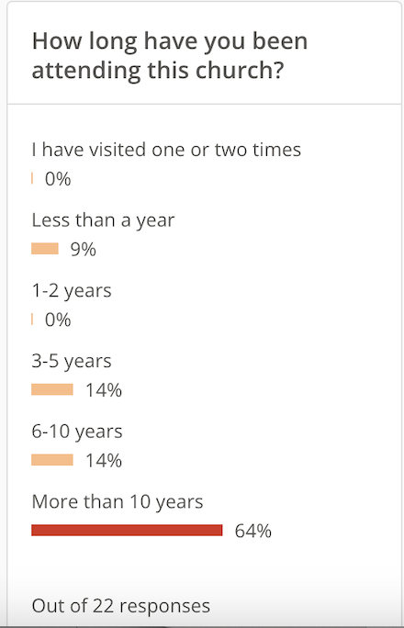
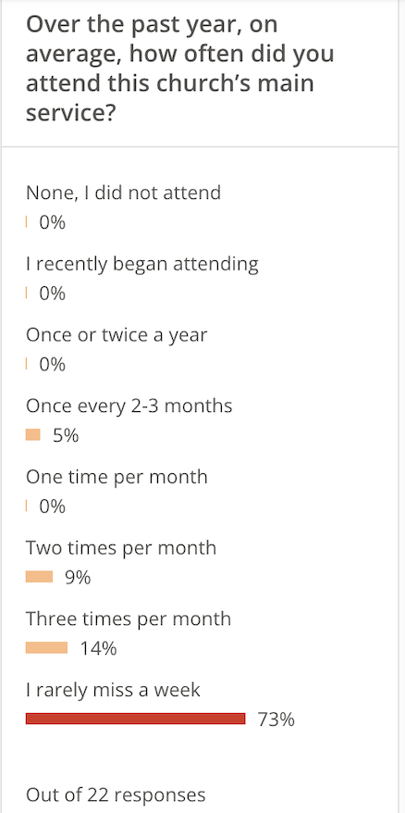
Share Rejoice
Survey Results
(15 minutes)
Out of 175 confirmed congregation members,
22 responded to survey

Slide 6
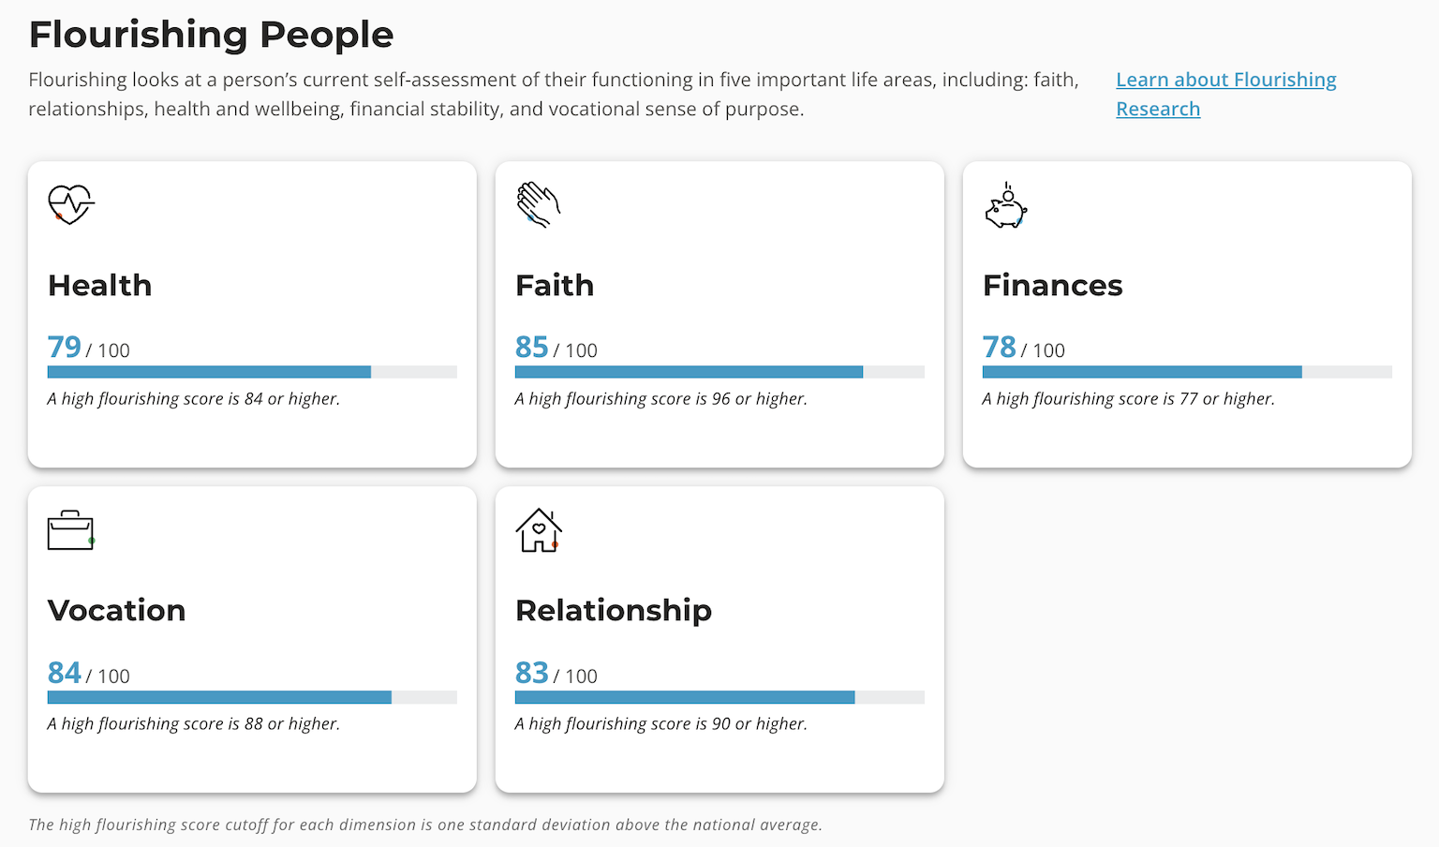
Share Rejoice Survey Results (cont.)

Slide 7
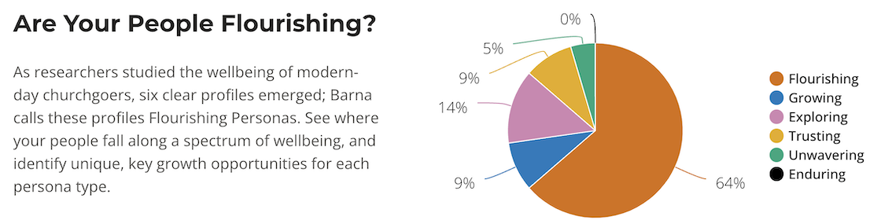
Share Rejoice Survey Results (cont.)

Slide 8
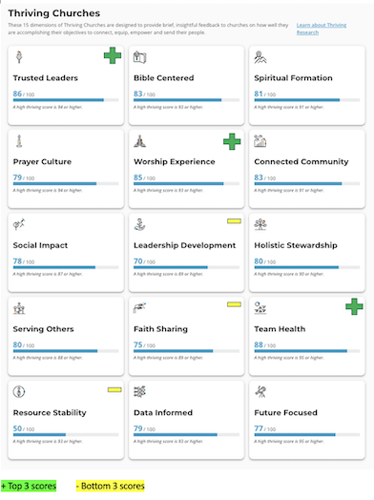
Share Rejoice Survey Results (cont.)
15 Dimensions of Thriving Churches

Slide 9
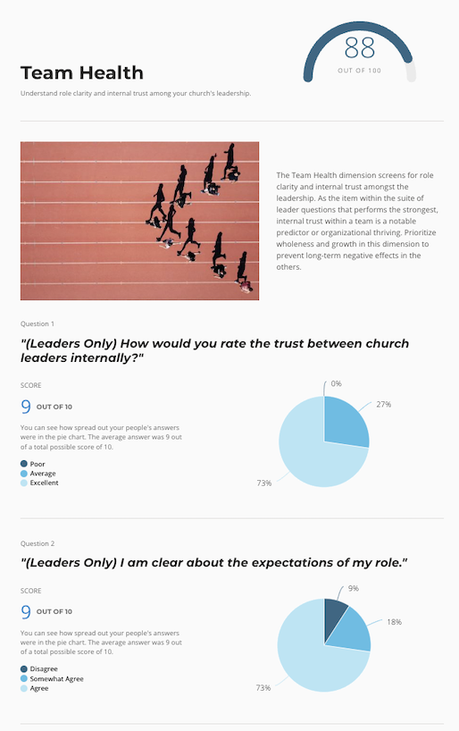
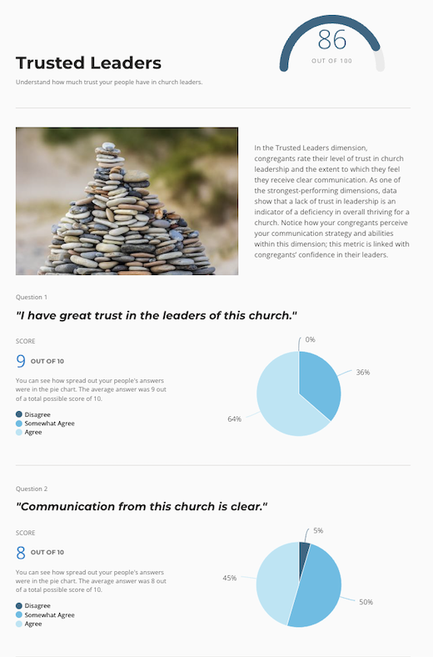
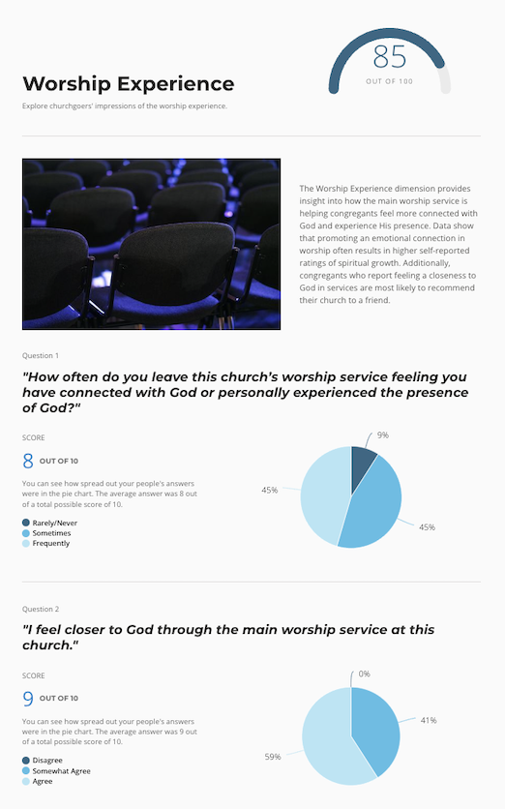
Share Rejoice Survey Results (cont.)
Top 3 Dimensions of Thriving Churches

Slide 10
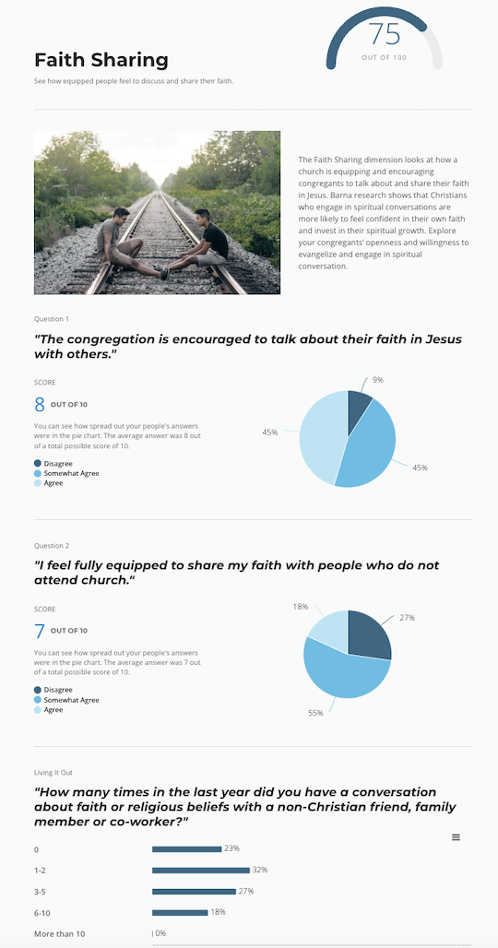
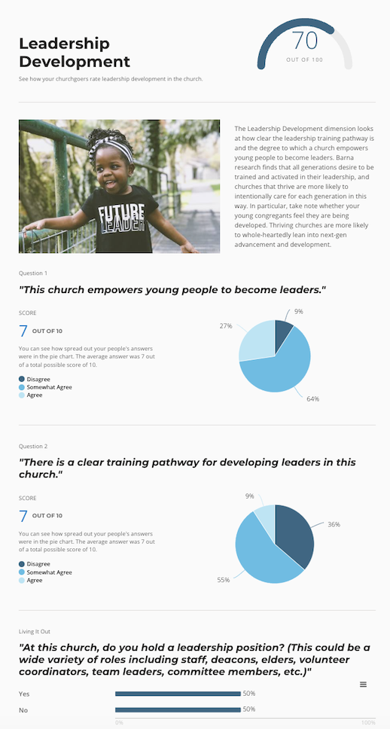
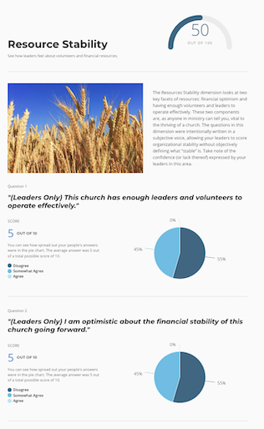
Share Rejoice Survey Results (cont.)
Bottom 3 Dimensions of Thriving Churches

Slide 11
Look ahead to the future – 15 minutes
Small Group Activity
Given what you’ve experienced in the past and learned from our survey results, create a visual of your aspirations for Rejoice’s future
  Not being graded as an art project
  Stick figures are fine
  Poster board, markers, etc. are available at your table

Slide 12
Large Group Debrief – 30 minutes
Debrief from each small group to share your visual
Identify 3 common themes between small groups

Slide 13
Small Group Activity – 30 minutes
Spin Charting
Given the 3 common themes, we’ll work on 4 rounds:
  Round 1: Each small group will work on one theme to record suggested goals, who’s responsible and due dates on a flipchart for 10 minutes
  Round 2: Combine small groups that are working on the same theme to review and combine their work and make any suggested changes for 10 minutes
  Round 3: Rotate to the next combined flipchart to review the previous group’s work and make any suggested changes for 5 minutes
  Round 4: Rotate to the last combined flipchart to review the previous group’s work and make any suggested changes for 5 minutes

Slide 14
Large Group: Wrap Up – 15 minutes
Recap next steps and create a communication plan
Audience | Key Points | Method | When | Who
Quit attending Rejoice | Summary & invitation | Letter/email/call | Oct. 8 | Rev. Neil
Easter/Xmas attendees? | Summary & invitation | Letter/email/call | Oct. 8 | Rev. Neil
Online attendees only | Summary & invitation | Blog | Oct. 8 | Rev. Neil
The Table | Summary & invitation | Meal | Oct. | Rev. Adam
Parents | Summary & invitation | Adult Ed | Oct. 8 | Rev. Neil/Jane
Gen Z (1999 or later) | Summary & invitation | SNL | Oct. 8 | Rev. Adam
Millennial (1984-1998)) | Summary & invitation | College care | Oct. 8 | Rev. Neil/Jane
Gen X (1965-1983) | Summary & invitation | Adult Ed | Oct. 8 | Rev. Neil/Jane
Boomer (1946-1964) | Summary & invitation | Adult Ed | Oct. 8 | Rev. Neil/Jane
Elder (1925-1945) | Summary & invitation | Empty Nesters | Oct. | Dave Grieser

Slide 15
Closing Prayer

